Slide 1

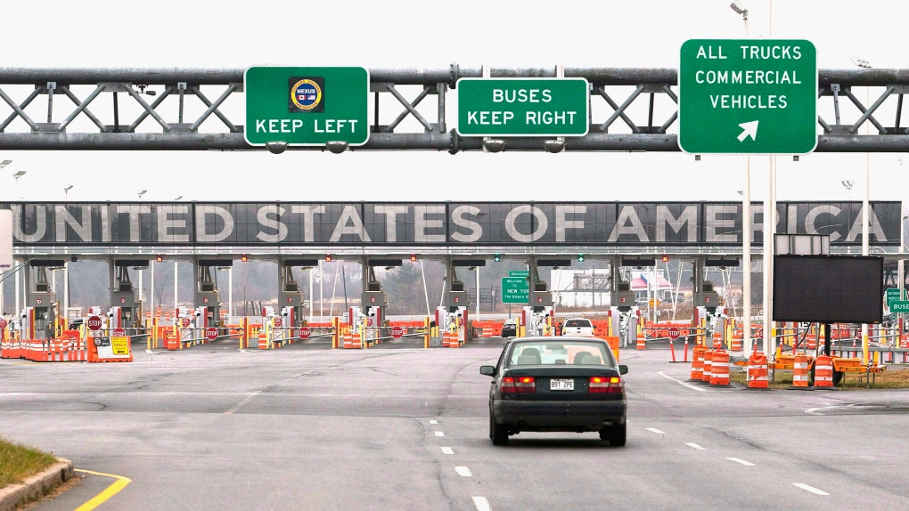
BORDER CROSSING DATA ANALYSIS
Group 4 : Sara , Set and Lynn Hoang

Slide 2
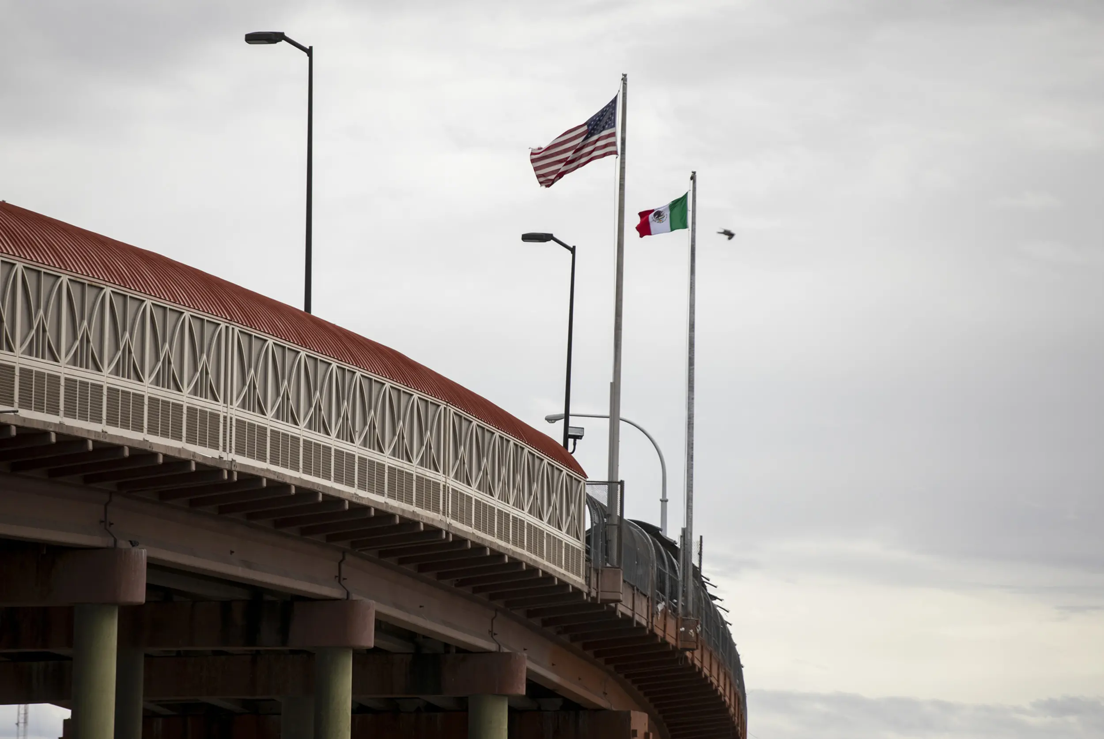
INTRODUCTION
Data collection: Kaggle and OpenWeatherMap API
Data cleaning
Data limitations: Time frame and Traffic Flow

Slide 3
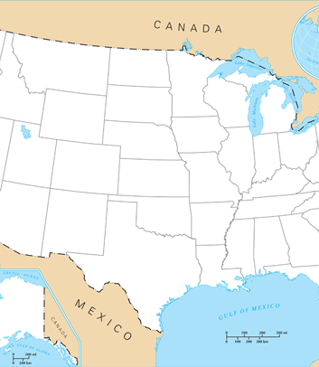
Question 1 – What is the busiest border in the US?

Slide 4
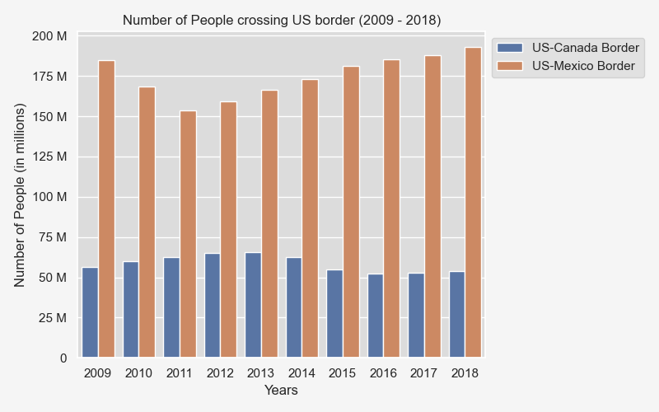
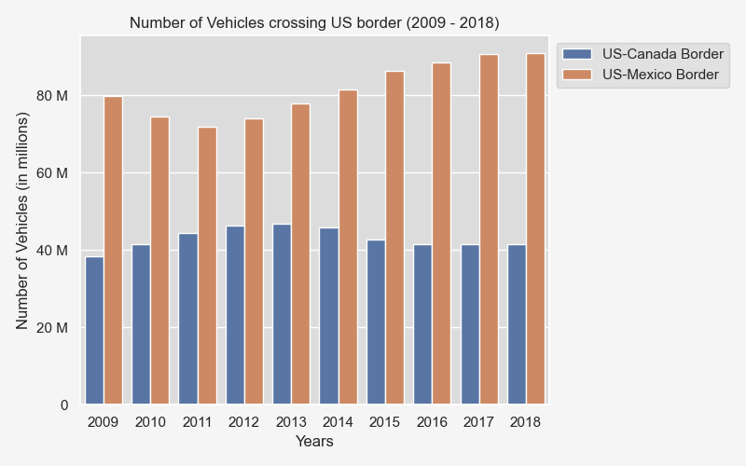
What is the busiest border in the US ?
Question 1
US-Mexico border people traffic is 3 times higher than the US-Canada border.
The vehicle traffic for the US-Mexico border is 2 times higher than US-Canada border.

Slide 5

Question 2 - Which are the top five busiest ports between US and Canada?

Slide 6
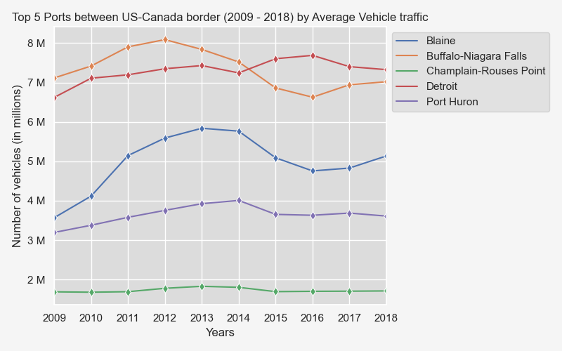
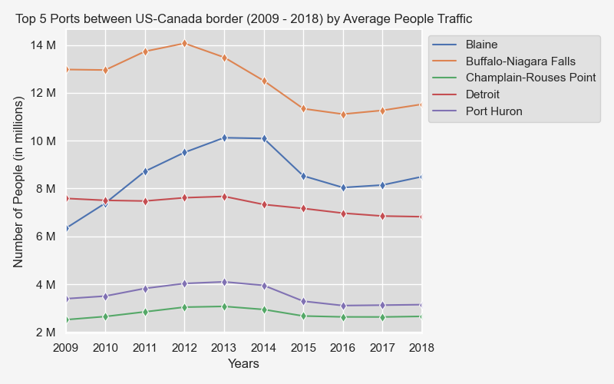
People versus Vehicle traffic by port for US-Canada Border

Slide 7
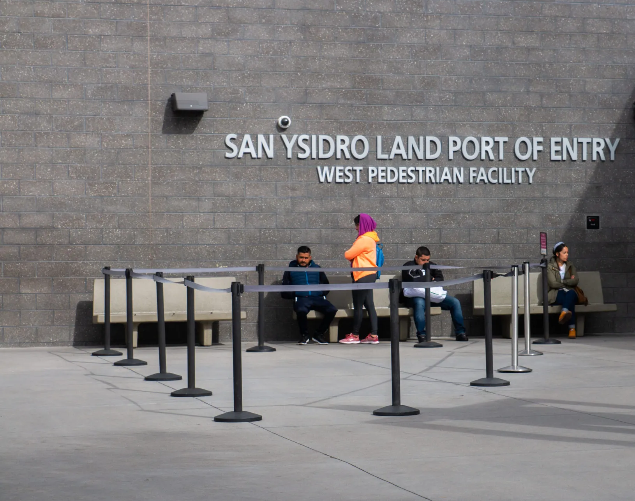
Question 3 - Which are the top five busiest ports between US and Mexico?

Slide 8
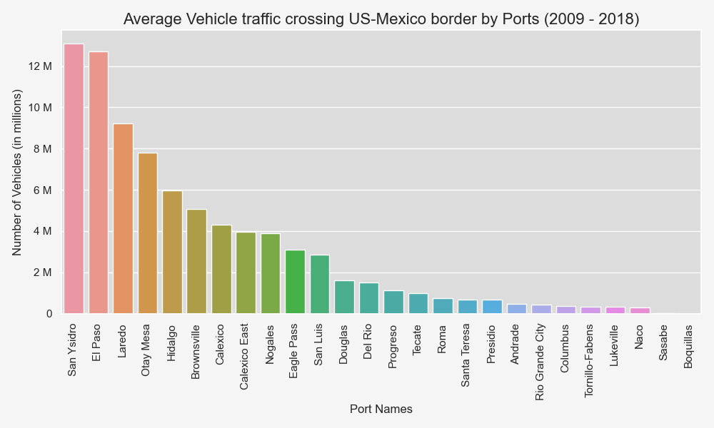
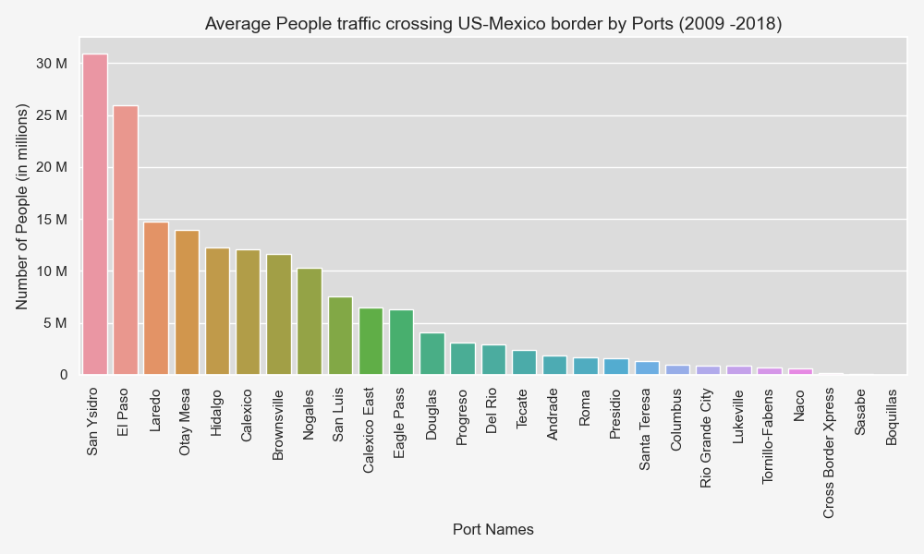
Question 3: Which are the top 5 busiest ports between US and Mexico across the 10 years?
Top 5 busiest ports
San Ysidro
El Paso
Laredo
Otay Mesa
Hidalgo

Slide 9
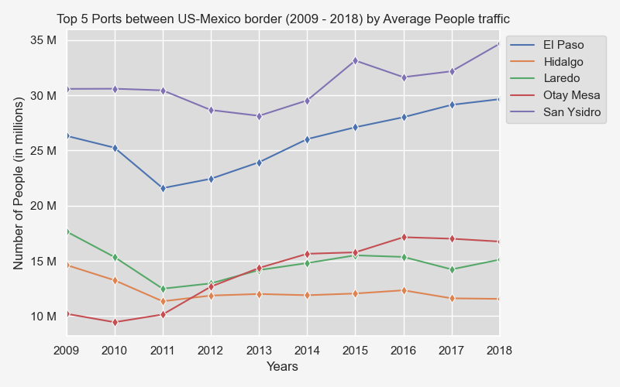
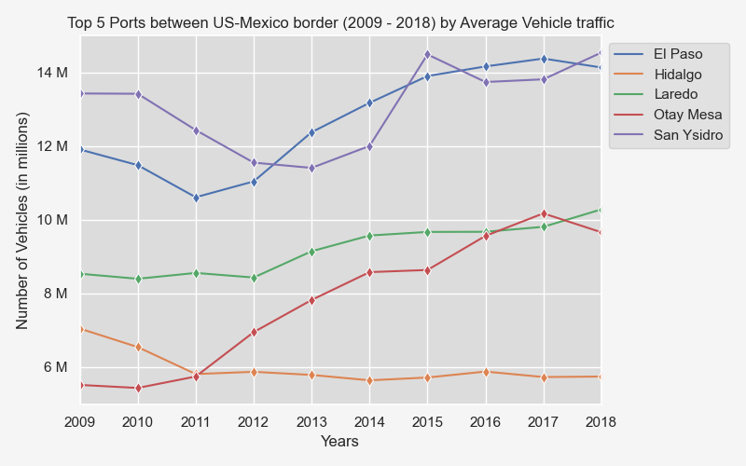
El Paso and San Ysidro remain the most popular ports to cross along the US - Mexico border.
From 2011 onward, there is an upward trend in inbound crossings at all the ports with the exception of Hidalgo.

Slide 10
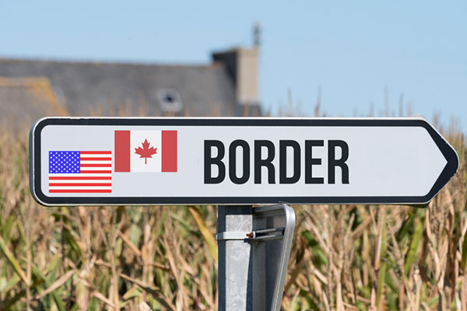
Question 4 - Which are the top three busiest states between US and Canada?

Slide 11
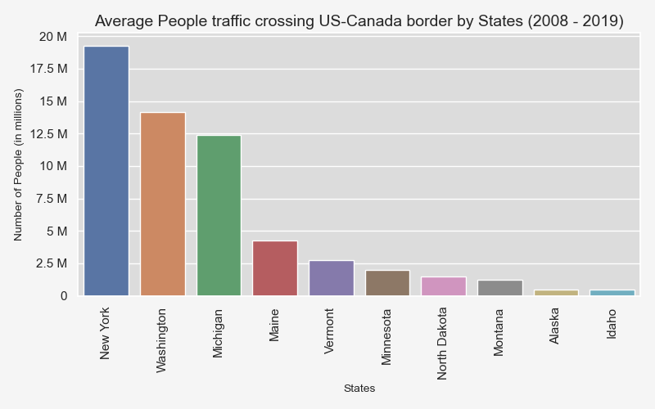
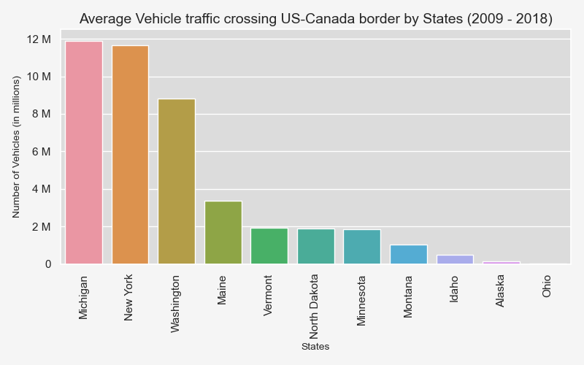
Top three busiest states between US and Canada

Slide 12
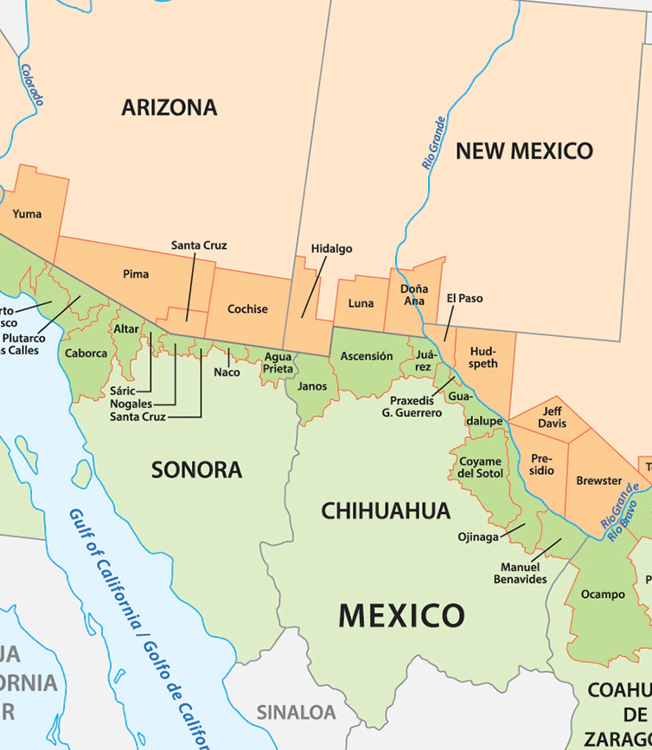
Question 5: Which are the top 3 busiest states across US-Mexico border?

Slide 13
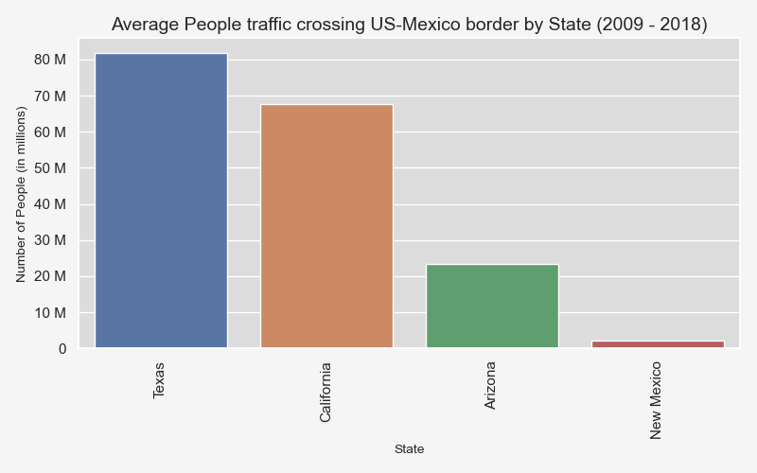
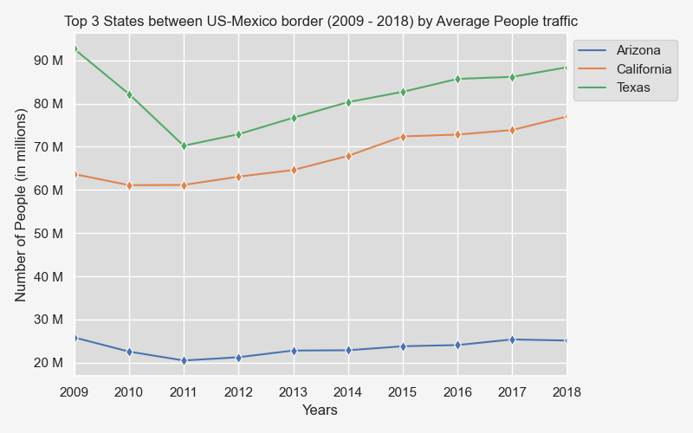
More than 80 million people crossed the border on average into the US from Texas.
Texas remains the most active state in regards to border crossings.

Slide 14
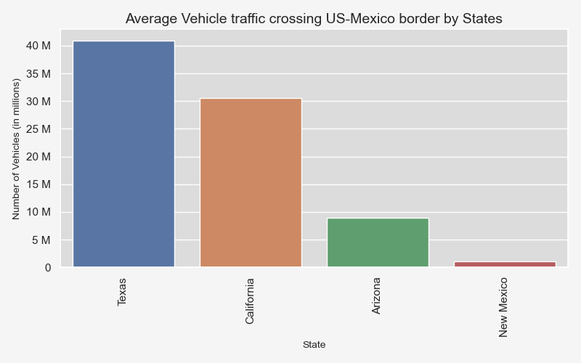
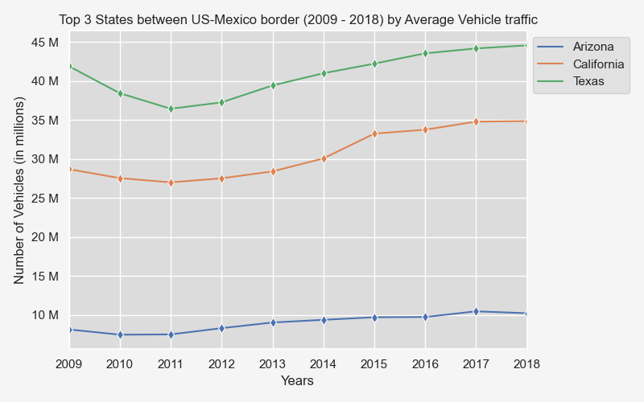
More than 40 million vehicles crossed the border on average into the US from Texas.
Texas remains the most active state in regards to border crossings.

Slide 15
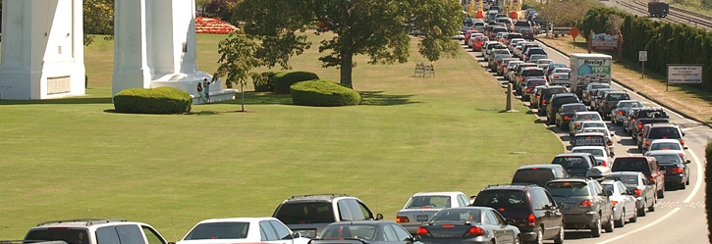
Question 6: What vehicle type is used the most?

Slide 16
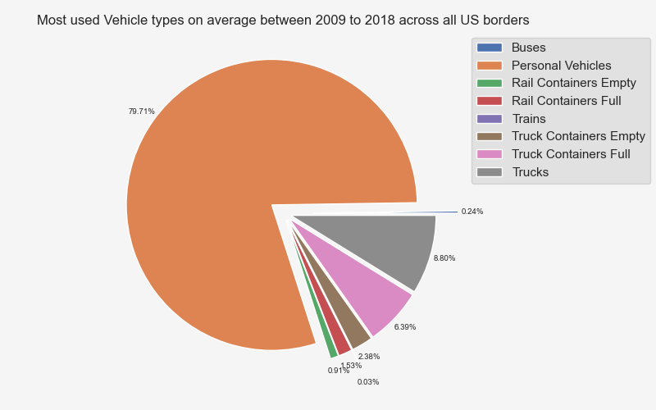
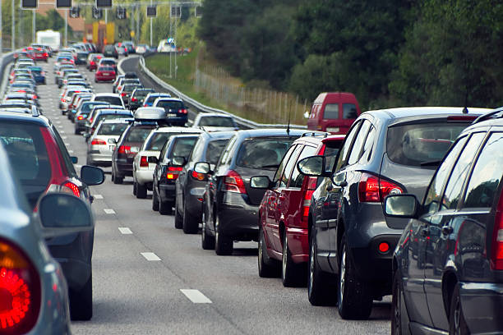
Personal vehicles represent 79.7% of the vehicle volume across the 10 years.

Slide 17
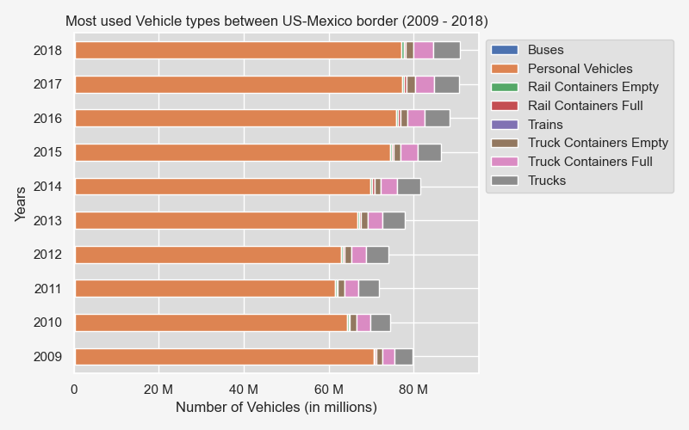
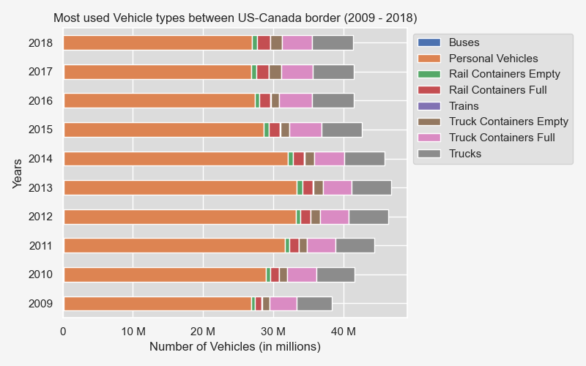
Vehicle Usage across the borders

Slide 18
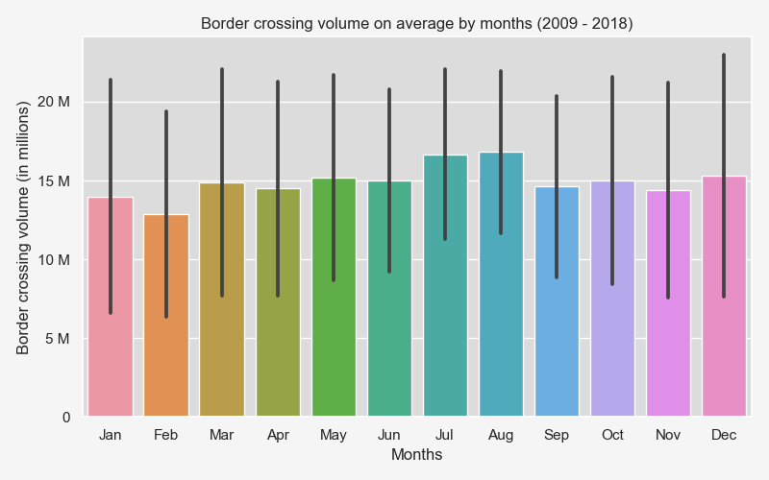
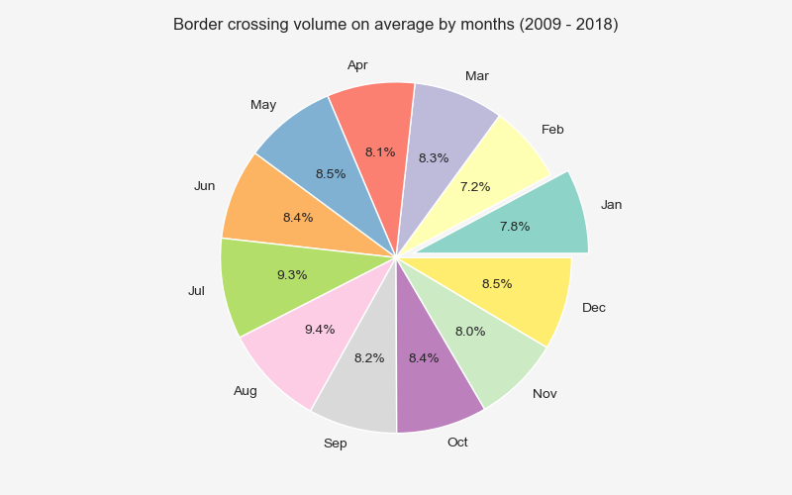
Question 7: What months are the busiest?
July (9.3%) and August (9.4%) are busier months of the year
February (7.2%) and January (7.8%) are slower months of the year

Slide 19
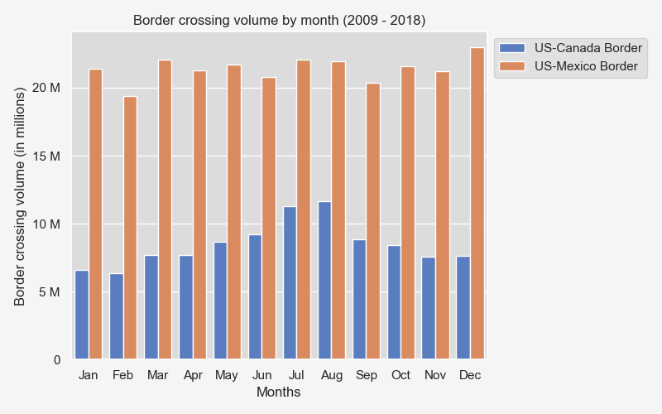
More traffic in the summer (US - Canada)

Slide 20

Question 8: Do weather conditions impact the border crossing traffic volume?

Slide 21
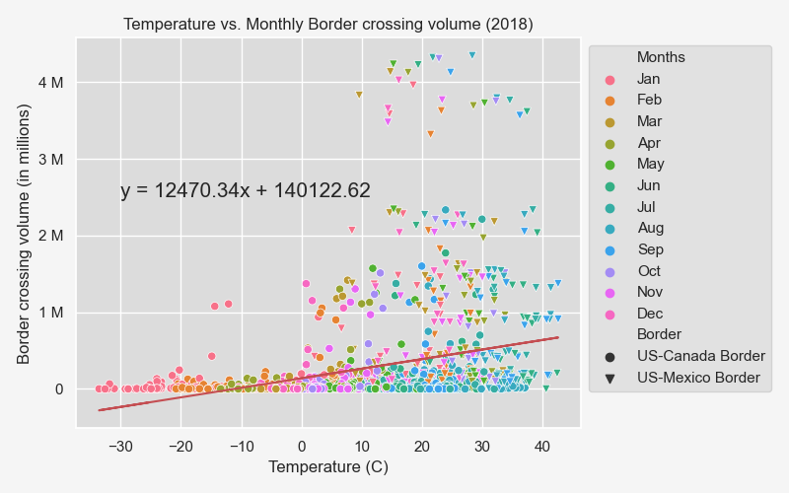
r-value = 0.2943

Slide 22
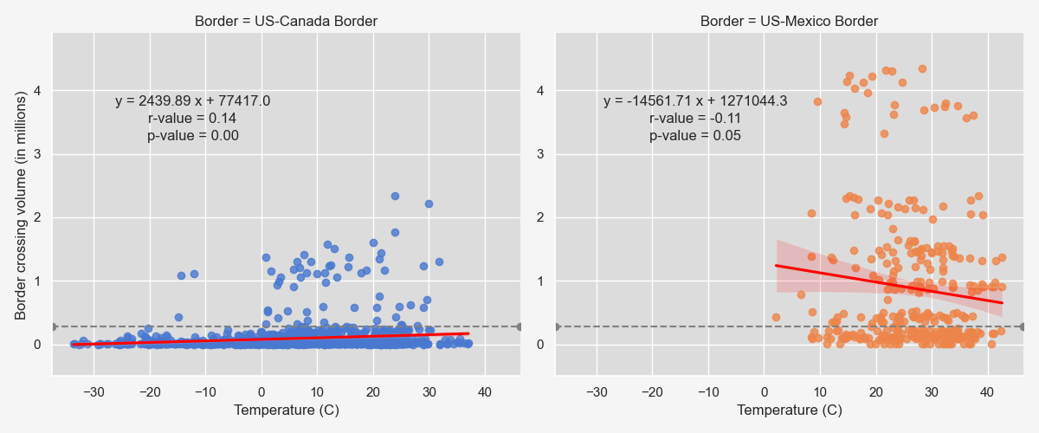

Slide 23
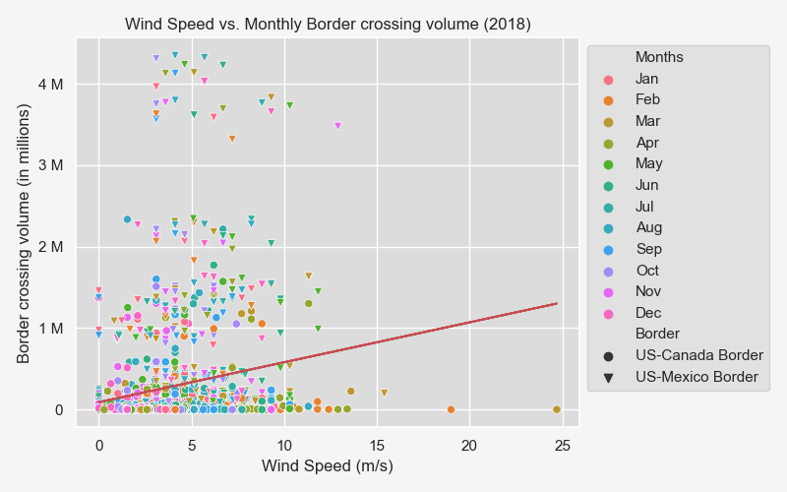
r-value = 0.1953

Slide 24
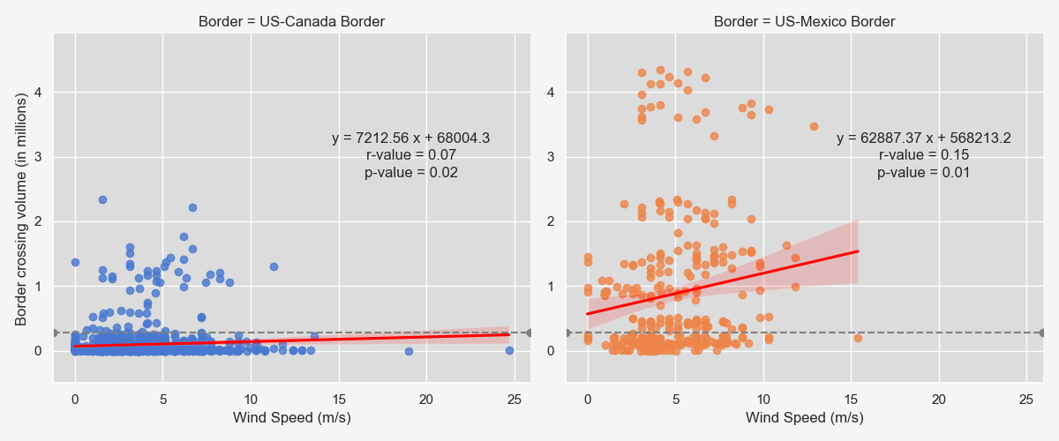

Slide 25
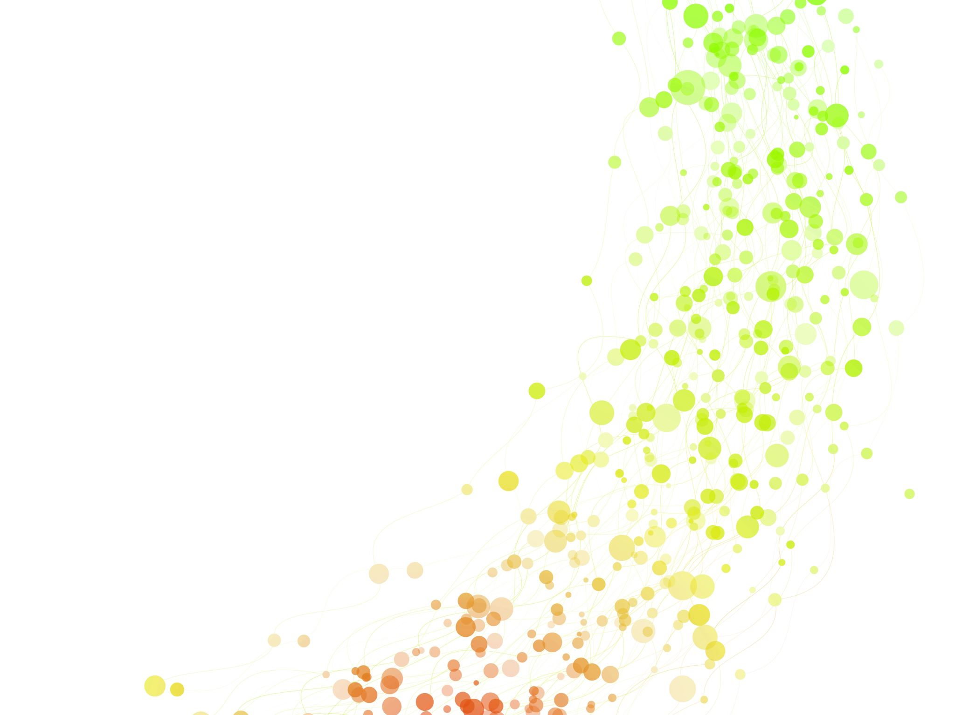
CONCLUSION

Slide 26
Q&A

